Slide 1
Three dimensional Knapsack problems
Phase 1.3, group 2

Slide 2
contents
Problem description
Possible solutions
Algorithms that were used
Results for boxes
3D visualization
Results for pentominoes
Conclusions

Slide 3
Problem description
This project is about solving a three dimensional knapsack problem:
A cargo-space (with dimensions 16.5 x 2.5 x 4.0 ) has to be filled with parcels of different sizes and values in a way that the maximum value is reached
Boxes as parcels: A: 1.0 x 1.0 x 2.0; B: 1.0 x 1.5 x 2.0; C: 1.5 x 1.5 x 1.5
Pentominoes as parcels: each block of the letter being a square of 0.5
user friendly interface to decide on the variety and amount of different parcels
Questions:
a/c) is it possible to fill the complete cargo- space with the parcels?
b/d) what is the maximum value that you can store in your cargo-space if the parcels represent values of 3, 4 and 5 unites respectively?

Slide 4
Possible solutions
Random algorithm as a solution for a)/c) and to compare with b)/d)
Backtracking algorithm as a solution for a)/c):
→ goes trough every possible combination of parcels to check if the space can be filled completely
Greedy algorithm as a solution for b)/d):
→ decides step by step what the highest value for the next few coordinates is and puts the parcel there if it fits
Dynamic programming as a solution for b)/d):
→ divides the problem into smaller tasks and solves them first in order to combine them recursively

Slide 5
Algorithms that we used
Random algorithm and greedy algorithm
Reason for our choice:
Easier than other algorithms
Fast
Sorting method 1: density of boxes (density = value * 100 / volume)
Sorting method 2: insertion sort according to density

Slide 6
Pseudocode for the sorting method
INPUT: unsorted array
OUTPUT: new sorted array
FOR (each box in the array from front to back)
FOR (the current box check from back to front (because it still might not be in order))
IF (density of current box > density of next box)
switch the indexes of the boxes
RETURN the sorted array

Slide 7
Pseudocode for the solve method
FOR (each element in the array boxes)
FOR (the next x- coordiante which is still in the truck)
FOR (the next y- coordiante which is still in the truck)
FOR (the next z- coordiante which is still in the truck)
IF (box is still available)
FOR (the current rotation)
IF (it fits in the empty space of the truck) place the box
ELSE try next x- rotation
IF (each x- rotation tried) rotate once on y- axes
IF (each y- rotation and all possible x- rotations tried) rotate once on z- axes

Slide 8
Pseudocode for the 3D visualization
For i in range of the length of the array
Create a box
If the box value = 5
Give it color red
Set the x,y,z coordinate to the to left most of the truck
Fill the line with boxes
If line is filled
X coordinate goes back to the starting X point
Fill the next line
If face is filled
X coordinate goes back to the starting X point
Y coordinate goes back to the starting Y point
Fill the next face

Slide 9
results for boxes: Can the cargo- Space be filled completely?
Only boxes of type A, B or C can not fill the space due to the size of these boxes:
Dimensions of boxes A: 1.0 x 1.0 x 2.0 cannot fill the width of 2.5 m
Dimensions of boxes B: 1.0 x 1.5 x 2.0 cannot fill the length of 16.5 m at the same time with filling out the 2.5 m width
Dimensions of box C: 1.5 x 1.5 x 1.5 cannot fill the height of 4.0 m

Slide 10
results for boxes: Can the cargo- Space be filled completely?
In the experiments done:
Not with the random algorithm
Not with the greedy algorithm if all boxes are used
Only using two box types:
0 boxes of type A
26 boxes of type B
22 boxes of type C
due to the greedy algorithm the only box chosen is box type A, if there are enough boxes of it
this can be achieved by using 4m as the depth, 2.5m as the height and 16.5m as the width

Slide 11
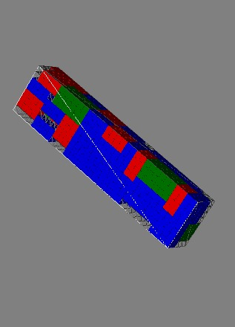
3D visualization
3D visualization of the best result
of the random algorithm

Slide 12
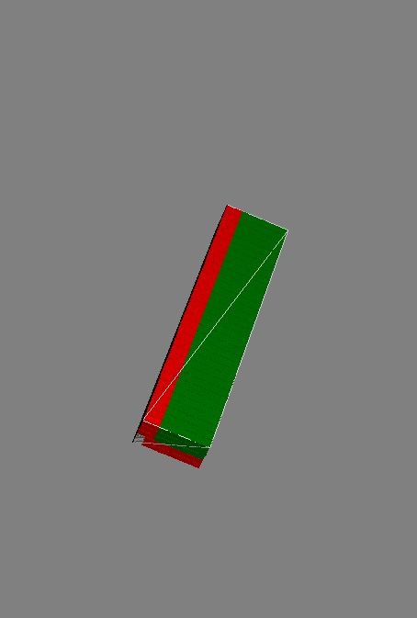
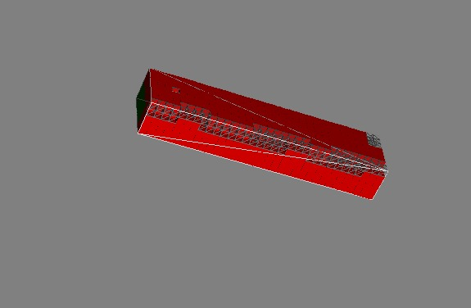
3D visualization
3D visualization of the result
for values A=3, B=4, C=5
(greedy algorithm)

Slide 13
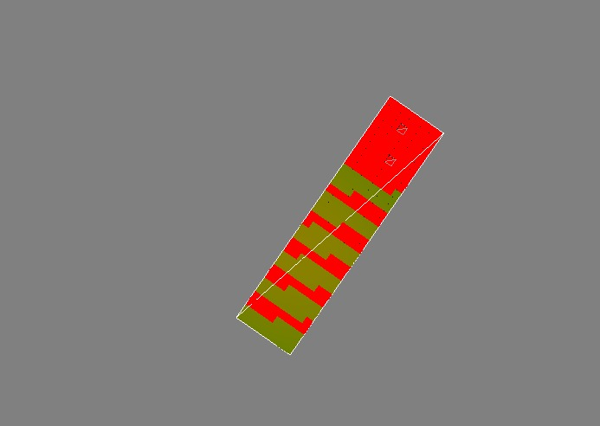
3D visualisation
3D visualisation of a completely filled cargo
for the values B=4, C=5
(greedy algorithm)

Slide 14
Results for Boxes: Maximum value of Cargo- space
For the given cargo- space and the values A=3, B=4, C=5 the maximum value of the greedy algorithm is 192 units
→ the random algorithm reaches 210 units
Higher value with greedy algorithm only possible when switching the values:
→ 320 units using only box A=5
→ 251 units using B=5 and A=4

Slide 15
Results for Boxes: Maximum value of Cargo- space
Gaining insight on the accuracy of the algorithms with experiments:
Changing the size of the cargo
Changing the values

Slide 16
Results for Boxes: Maximum value of Cargo- space
Changing the size of the cargo- space:
Bigger cargo- space (33mx5mx8m): greedy algorithm is much better than random algorithm
Cubic cargo- space (5mx5mx5m): greedy algorithm is better than random algorithm
Tiny cargo- space (8mx1mx2m): both algorithms have the same maximum value

Slide 17
Results for Boxes: Maximum value of Cargo- space
Increasing values to 30, 40, 50:
For the different sizes of cargo- space there the values are proportional
It would have been better to combine really small and really high values
→ this might have shown that the greedy algorithm works much better in such a situation, because it skips the boxes with the smaller value

Slide 18
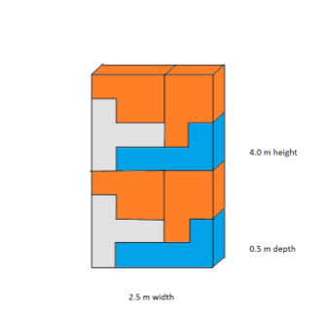
results for pentominoes: Can the cargo- Space be filled completely?
Not possible with random algorithm
Not possible with greedy algorithm
However, it is possible:
If one 2.5m x 4.0m x 0.5m ’slice’ of the cargo is filled such as shown in the picture and 33 ‘slices’ are placed side-by-side, this ﬁlls the cargo- space without gaps.

Slide 19
Results for Pentominoes: Maximum value of Cargo- space
For the given cargo-space and the values L=3, P=4, T=5
The maximum value for random: 1101 units
The maximum value for greedy: 1023 units

Slide 20
Results for Pentominoes: Maximum value of Cargo- space
Changing the size of the cargo- space:
Tiny cargo-space: results are almost the same
Cubic cargo-space: maximum result of random algorithm 20% higher than greedy algorithm (827 units versus 687 units)
Big cargo-space:
greedy algorithm only 2739 units
random algorithm achieves values between 8564- 8770 units
Increase of 220%

Slide 21
Results for Pentominoes: Maximum value of Cargo- space
Changing values:
Random algorithm again performs 220% better than greedy algorithm in big cargo- space
Maximum value of the cubic cargo- space increases insignificantly to 21%
The tiny cargo-spaces are almost the same

Slide 22
Results for Pentominoes: Maximum value of Cargo- space
Switched values:
Overall maximum value achievable for the given cargo- space is 1279 units (with P=4, T=5)
Maximum value for big cargo- space increases to 3432 units
→ still 156% less than the best random case with normal settings
Cubic cargo-space reaches best overall value: 870 units
Tiny cargo-space reaches best overall value: 118 units

Slide 23
conclusions
Greedy algorithm shows better results with
box shaped parcels
bigger spaces (if compact parcels are used)
Greedy algorithm performs very bad with more complex shapes, such that the random algorithm reaches far better results
There is almost no difference in the performance of the algorithms for small spaces

Slide 24
Group 2: wouter van elteren, kim roggenbuck, tobias mersch, hao yun

